Slide 1
The Water Cycle
By: Zalie Skolyak, Makayla Ayres, Kassidy Brightwell

Slide 2
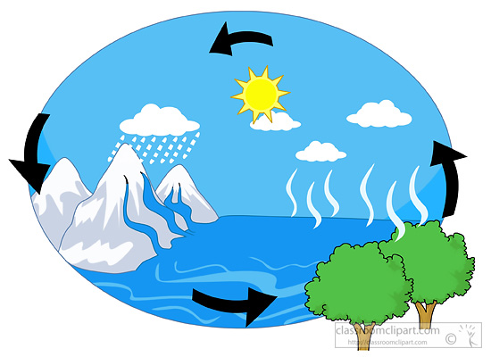
The Sun
Creates all weather and heats the Earth’s surface.

Slide 3
Liquid Water
All Things that are alive need liquid water to survive.

Slide 4
Evaporation
The sun heats the liquid water until it rises as water vapor into the atmosphere.

Slide 5
Condensation
Water vapor molecules join together in the form of clouds.

Slide 6
Dew Point
The dew point is reached before the water vapor falls as precipitation.

Slide 7
Precipitation
Water falling to Earth’s surface in the form of rain, sleet, hail, or snow.

Slide 8
Run off
When precipitation lands on a mountain it slides down which is known as run off.

Slide 9
Ground Water
When precipitation seeps into the ground it is known as ground water.

